Slide 1
MoSi meanders
vt02 _ spd_res _ sr02_01

Slide 2
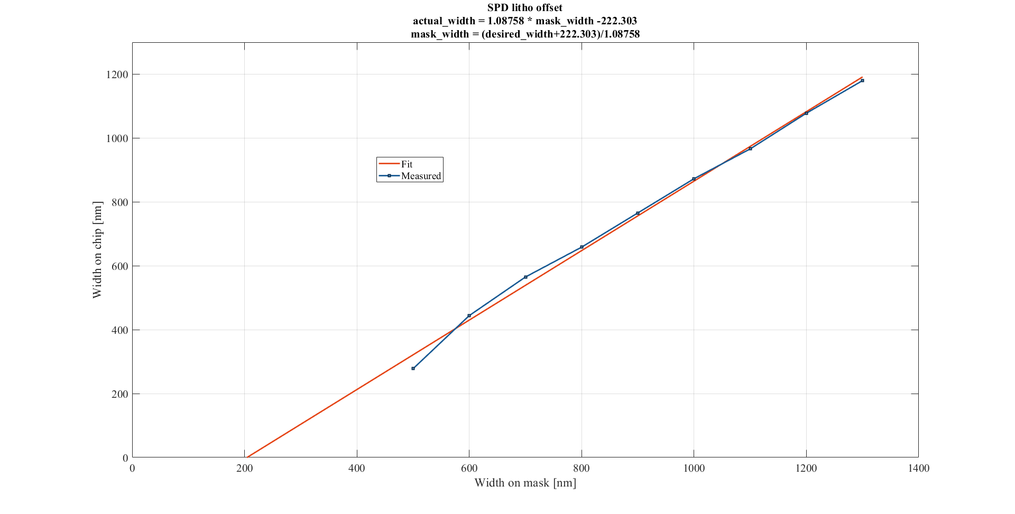

Slide 3
SEMs of meanders, measuring width of a wire in the middle of the meander

Slide 4
w_wire = 500nm on gds

Slide 5
w_wire = 600nm on gds

Slide 6
w_wire = 700nm on gds

Slide 7
w_wire = 800nm on gds

Slide 8
w_wire = 900nm on gds

Slide 9
w_wire = 1000nm on gds

Slide 10
w_wire = 1100nm on gds

Slide 11
w_wire = 1200nm on gds

Slide 12
w_wire = 1300nm on gds

Slide 13
IVs of meanders, measured in Sonia’s fridge between 2.8 K and 3.5 K

Slide 14
various wire widths, 7000 squares (assuming wires came out the gds width)

Slide 15
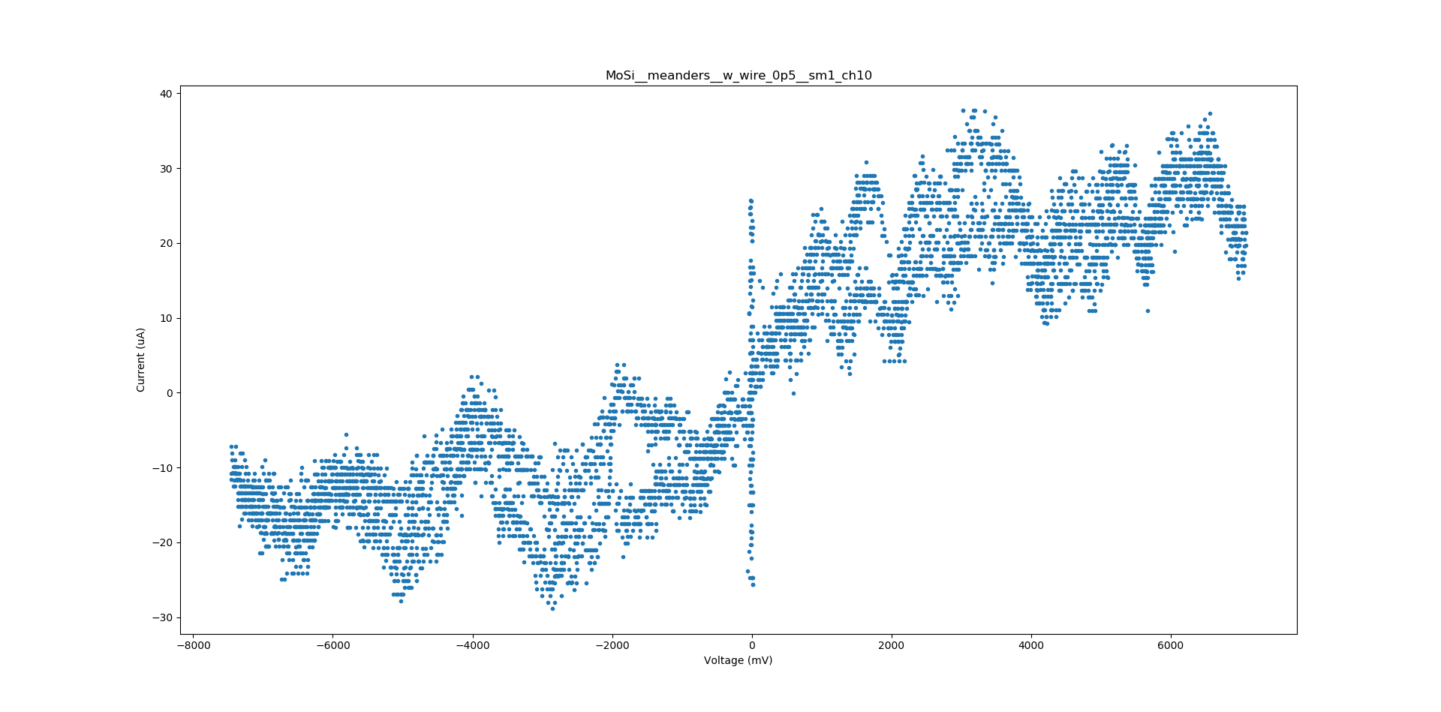
w_wire = 500nm on gds

Slide 16
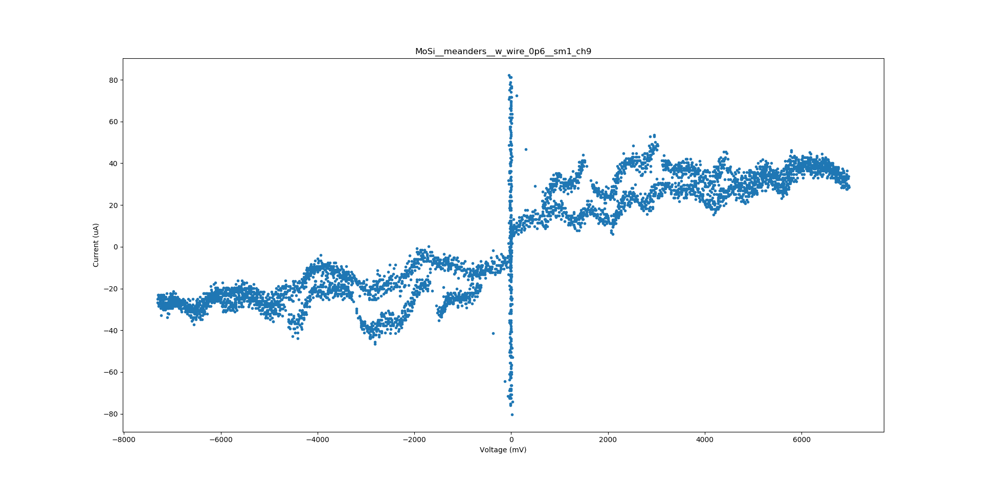
w_wire = 600nm on gds

Slide 17
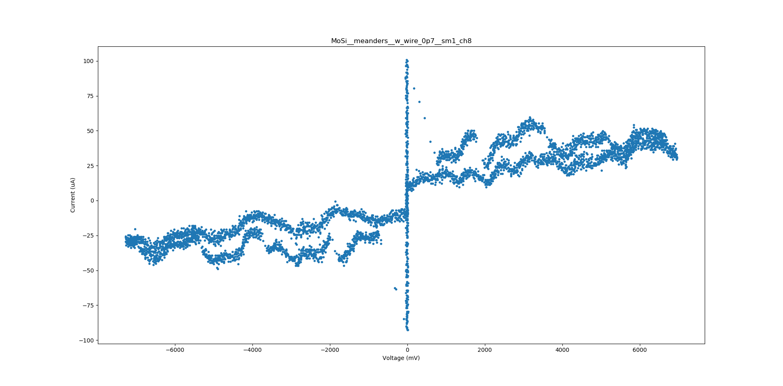
w_wire = 700nm on gds

Slide 18
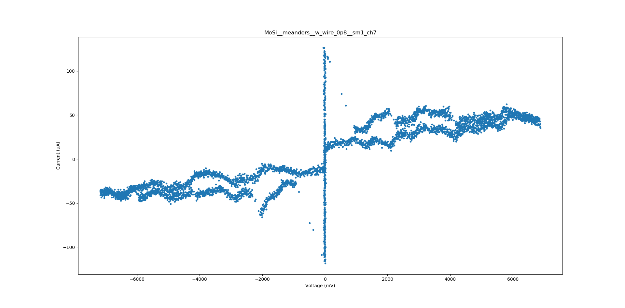
w_wire = 800nm on gds

Slide 19
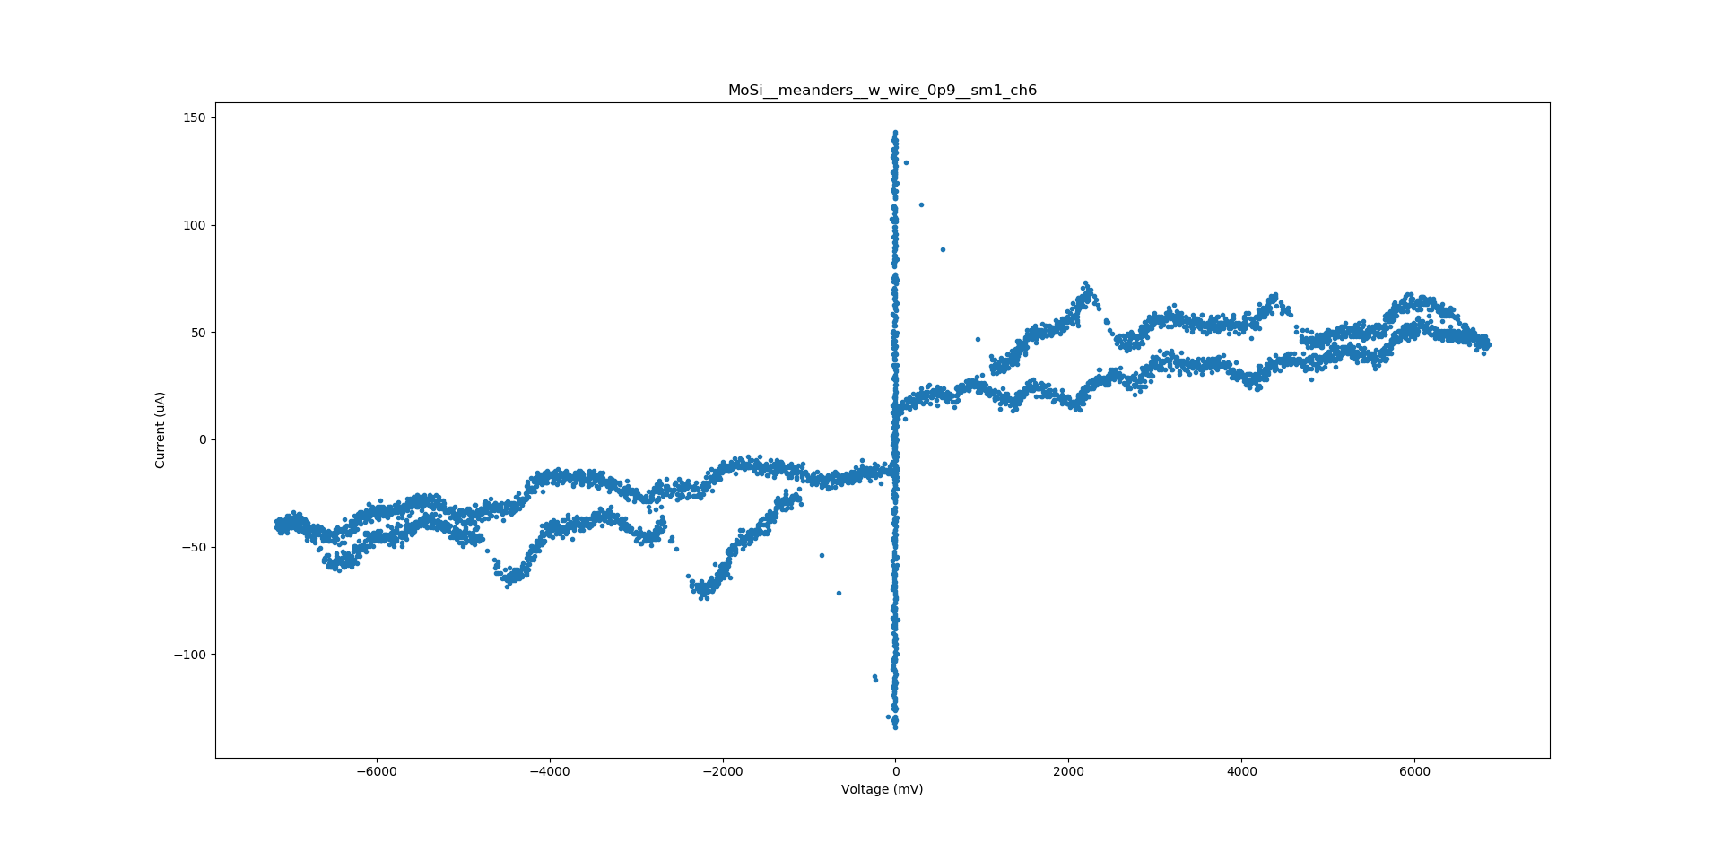
w_wire = 900nm on gds

Slide 20
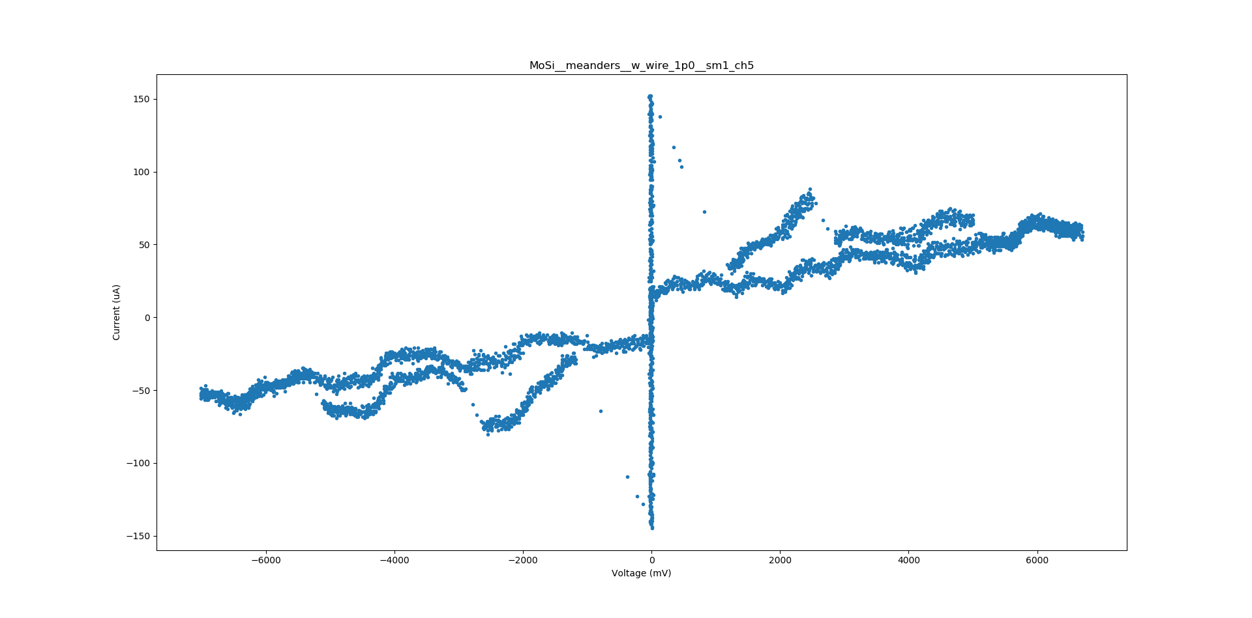
w_wire = 1000nm on gds

Slide 21
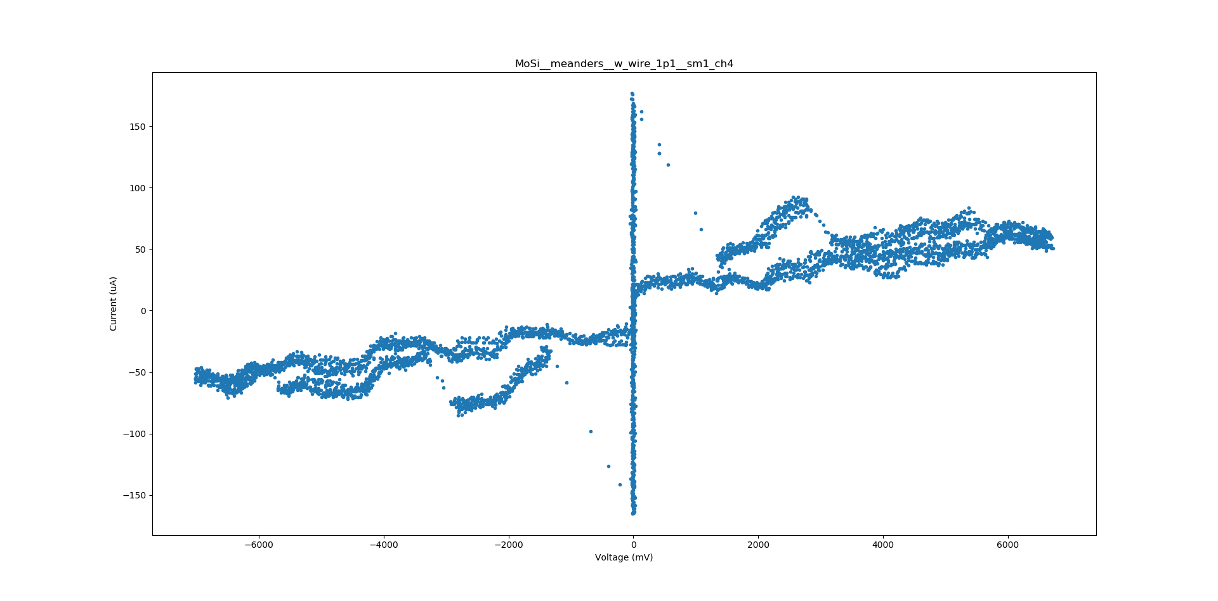
w_wire = 1100nm on gds

Slide 22
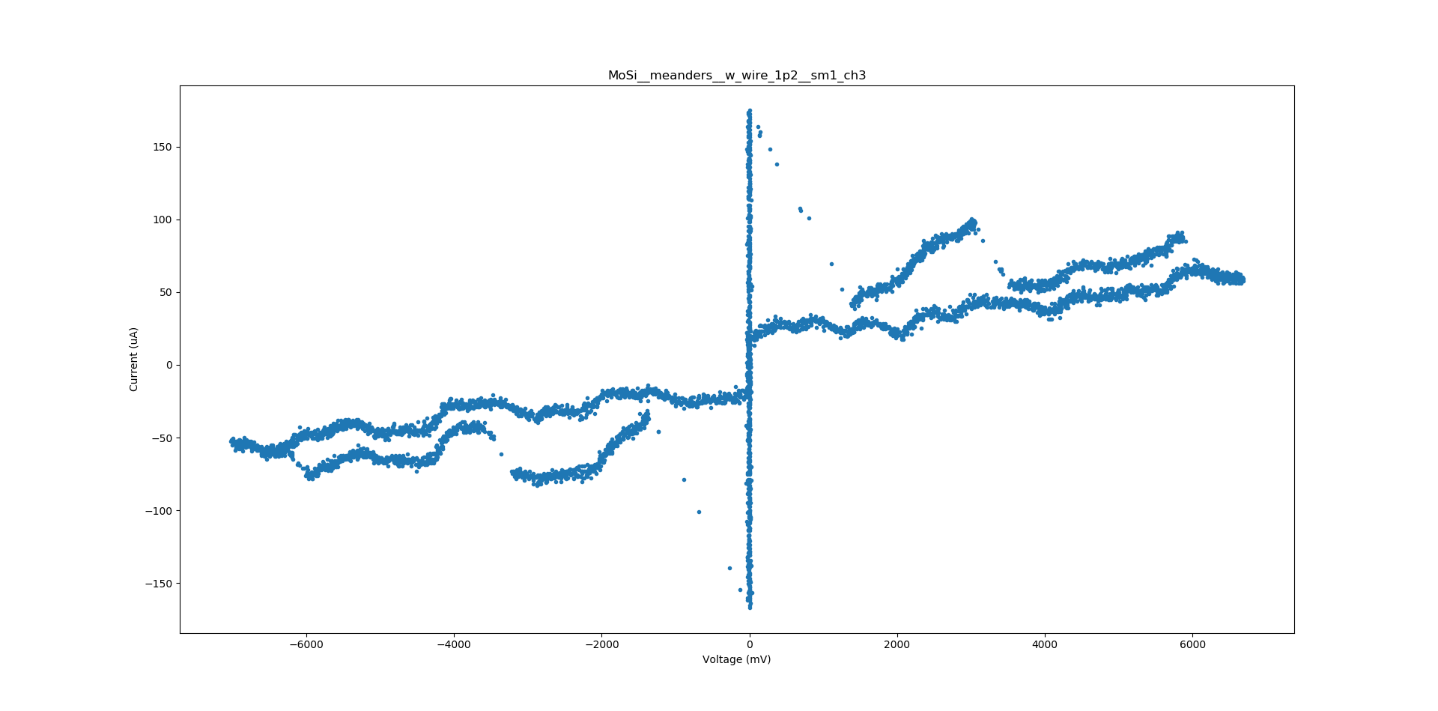
w_wire = 1200nm on gds

Slide 23
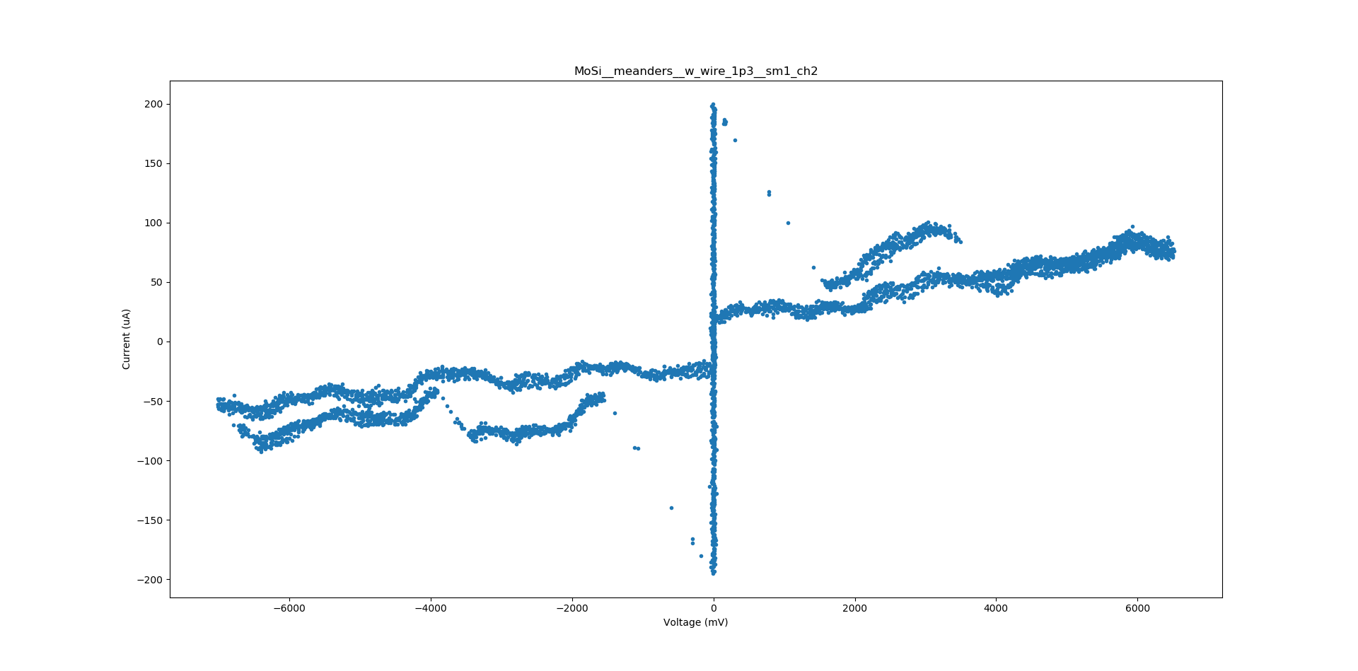
w_wire = 1300nm on gds

Slide 24
various wire lengths, 800nm-wide wire (on gds)

Slide 25
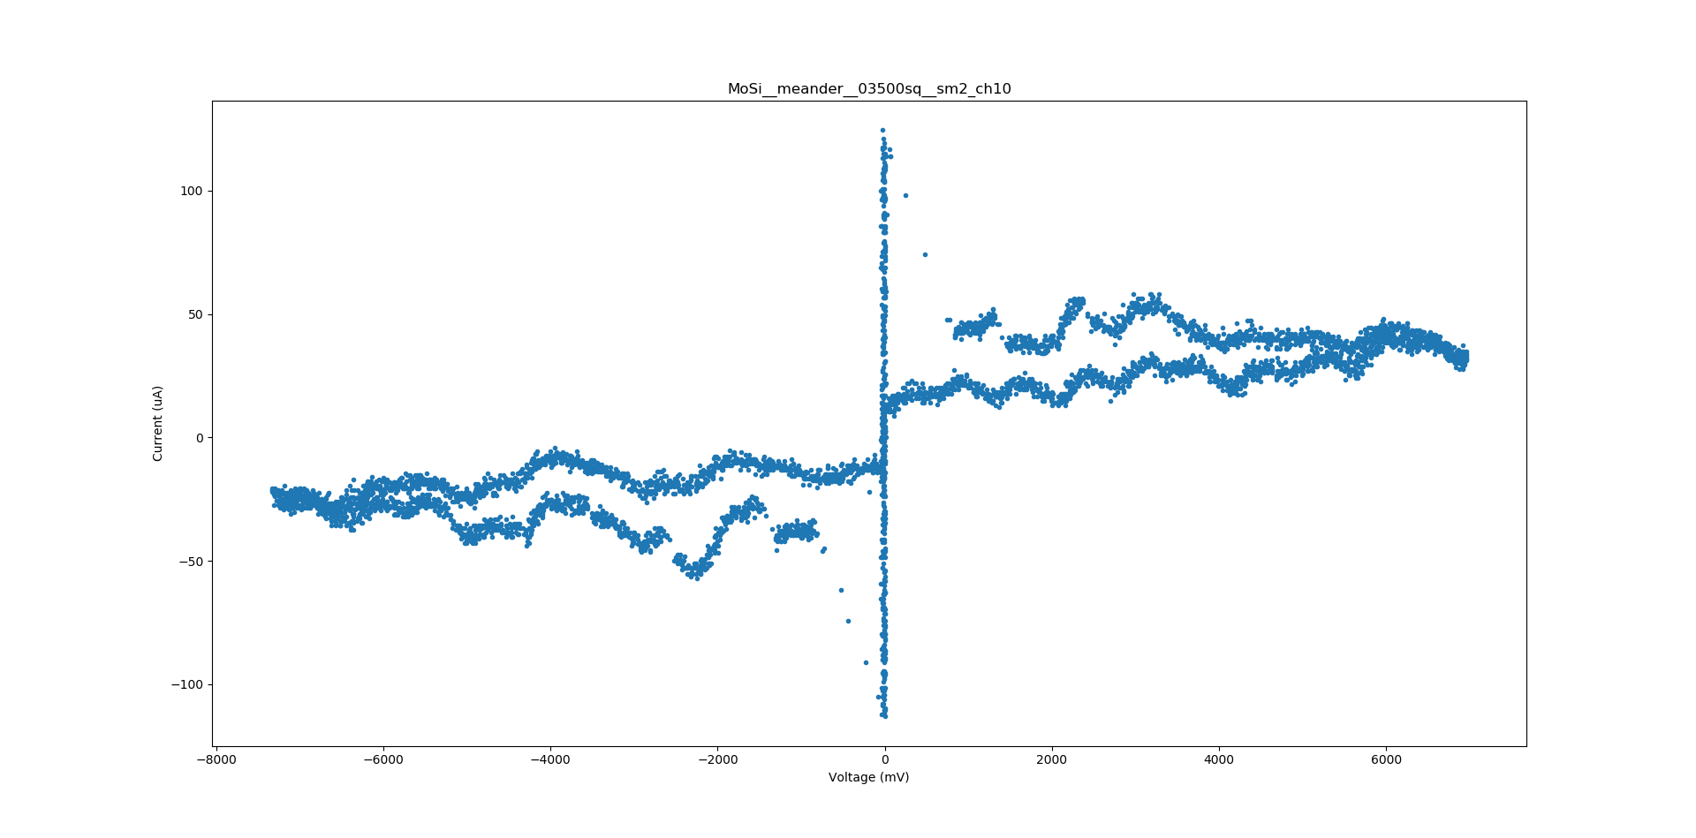
num_squares = 3500

Slide 26

num_squares = 4312

Slide 27
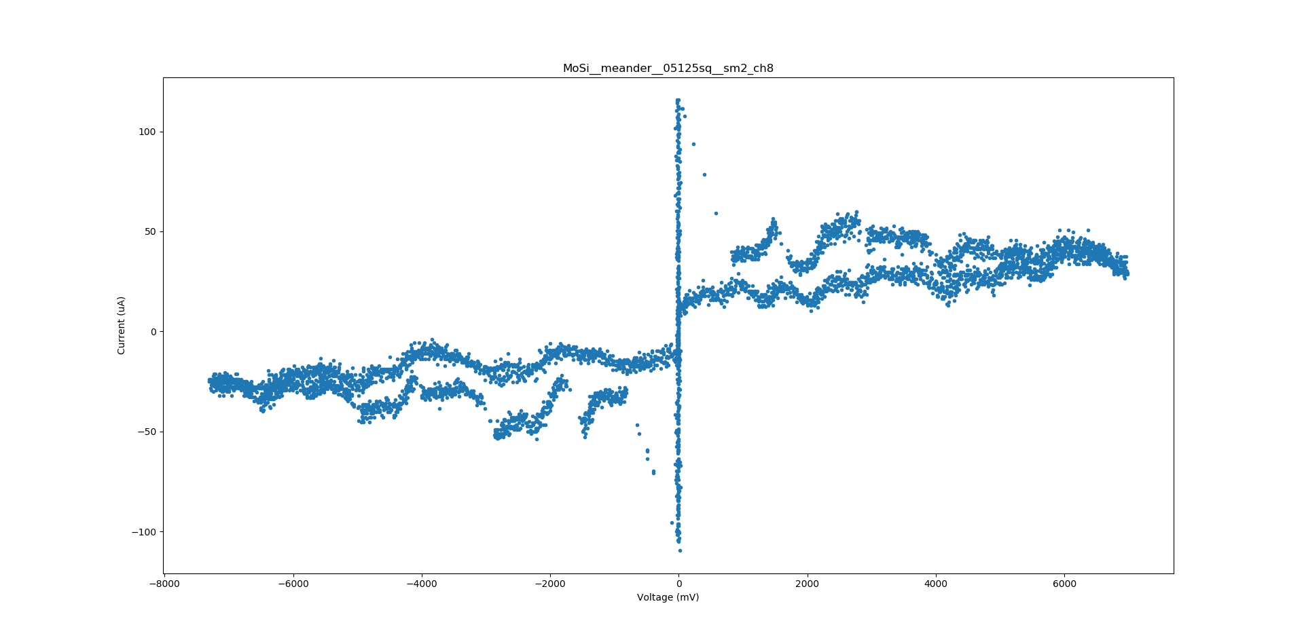
num_squares = 5125

Slide 28
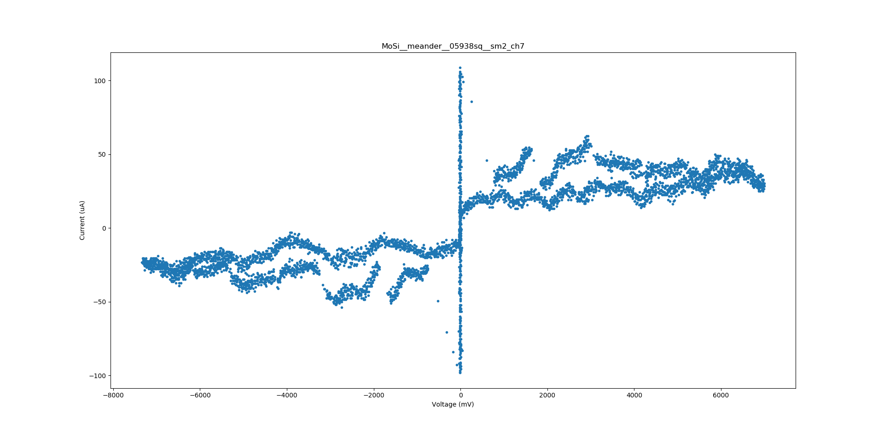
num_squares = 5938

Slide 29
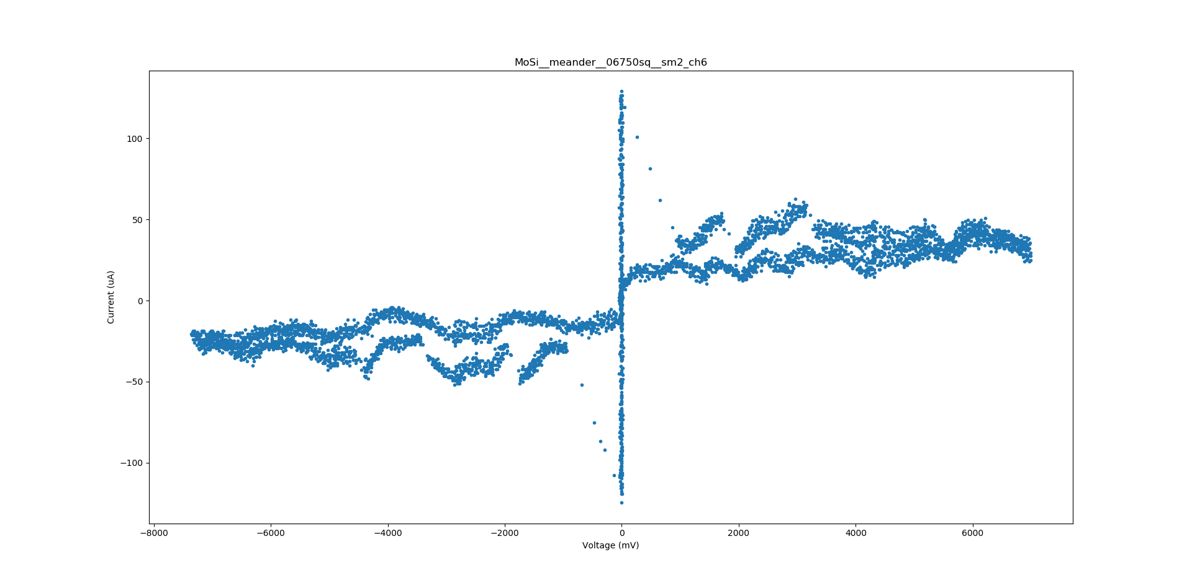
num_squares = 6750

Slide 30
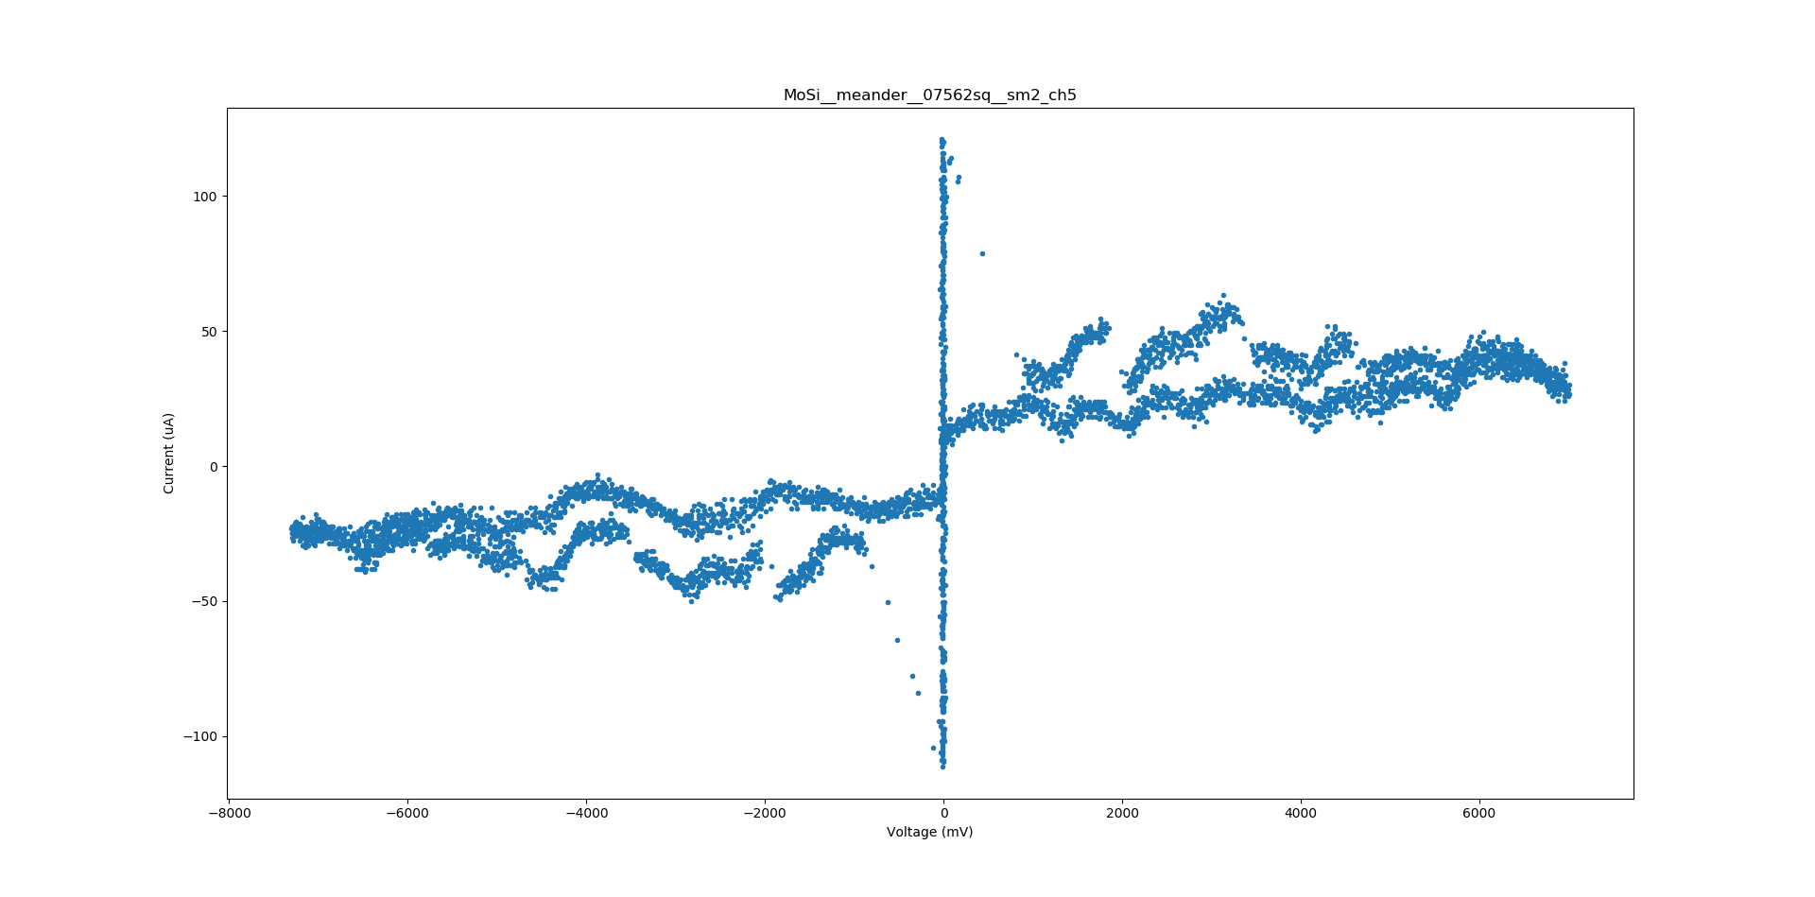
num_squares = 7562

Slide 31
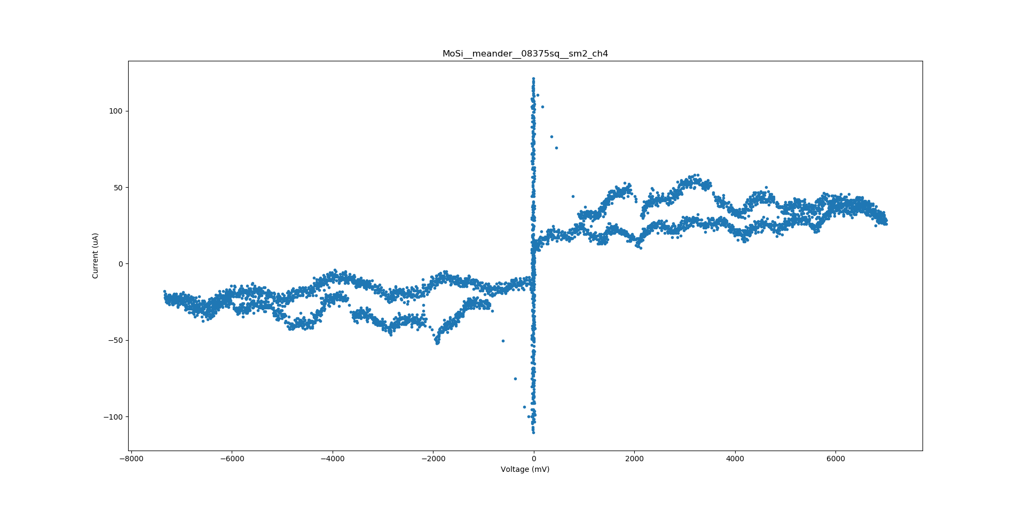
num_squares = 8375

Slide 32
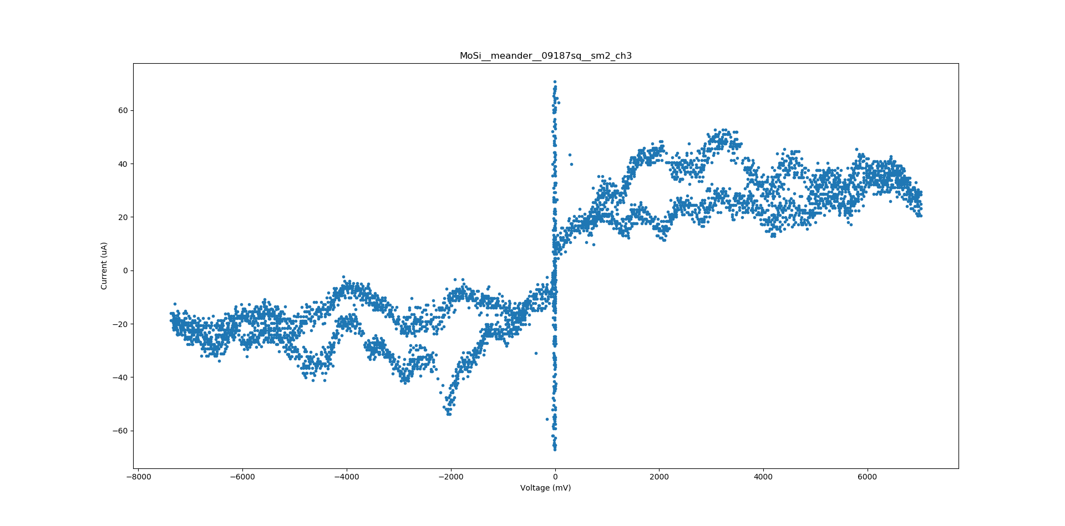
num_squares = 9187

Slide 33
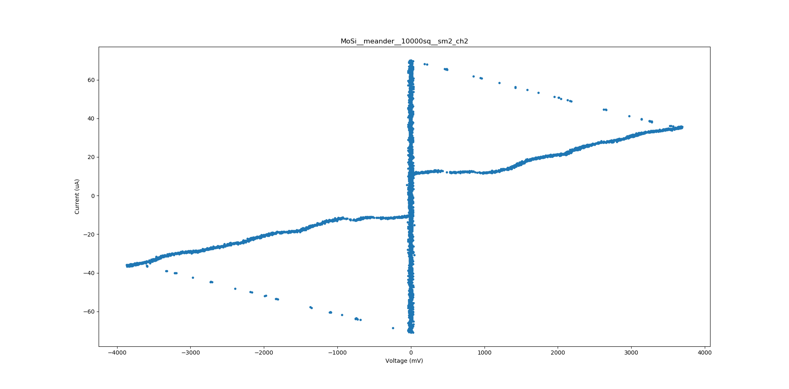
num_squares = 10000

